Slide 1
Prayer of Adoration
Yours, O Lord, is the greatness, the power, the glory, the victory, and the majesty. Everything in the heavens and on earth is yours, O Lord, and this is your kingdom. We adore you as the one who is over all things. – 1 Chronicles 29:11

Slide 2
Prayer of Adoration
“Worthy are you, our Lord and God, to receive glory and honor and power, for you created all things, and by your will they existed and were created.” – Revelations 4:11

Slide 3
Prayer of Adoration
All the nations you have made shall come and worship before you, O Lord, and shall glorify your name. – Psalm 86:9

Slide 4
AFReG Mission & Purpose

Slide 5
African Diaspora Prayer areas
Community
Church
Connections
(Community, Church, and People)

Slide 6
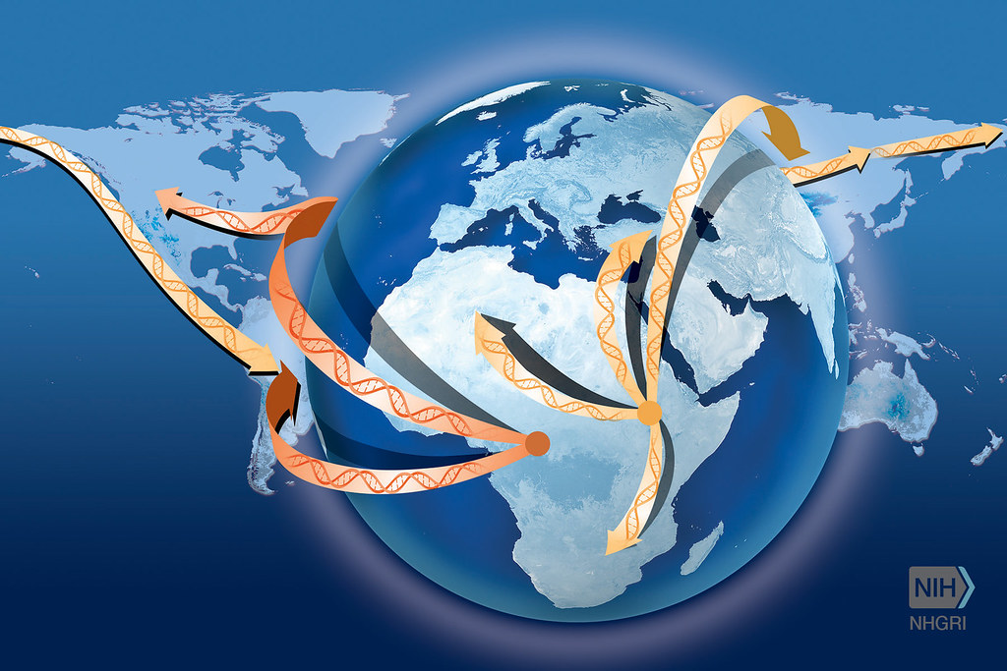
Prayer Items Pray against the symptoms of historical trauma: * Violence and suicide * Depression * Anxiety * Isolation * Loss of Sleep * Anger * Discomfort around White people * Shame * Fear of distrust * Loss of concentration * Substance abuse
People of the African Diaspora continue to be faced with Past Trauma (HISTORICAL TRAUMA)
Historical trauma, as described by most scholars, is the cumulative emotional and psychological wounding over one's lifetime and from generation to generation following loss of lives, land, and vital aspects of culture. People of the diaspora often face increased (micro) aggressions, discrimination, and racism.

Slide 7
African Diaspora Prayer areas
THE IMPACT AND LEGACIES OF SLAVERY ON THE DIASPORA
Prayer Items

Slide 8
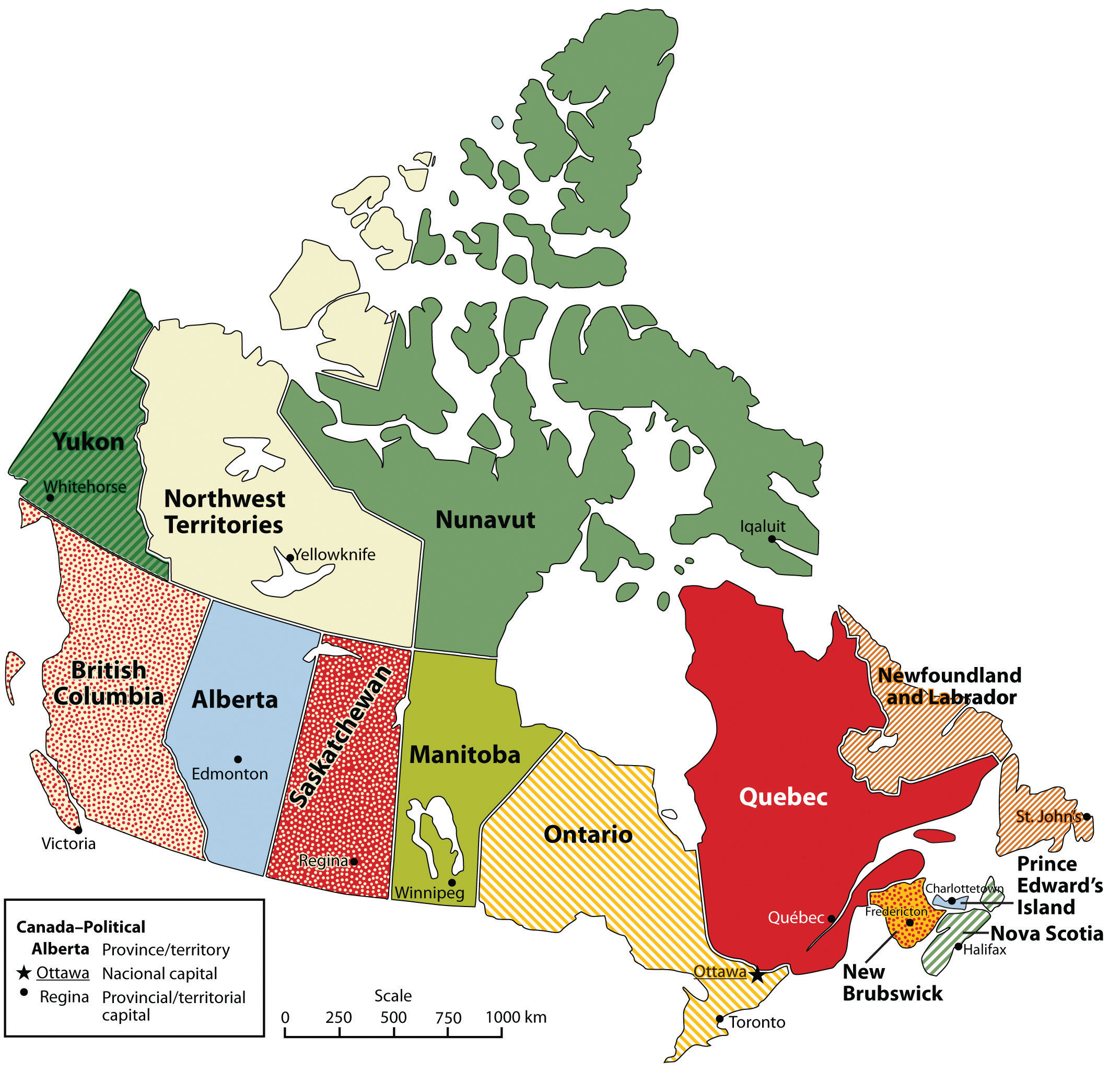
CANADA
Prayer items:
The unity of the church
Revival in Canada
The evils of systemic racism to be addressed in the nation and hearts of the people

Slide 10
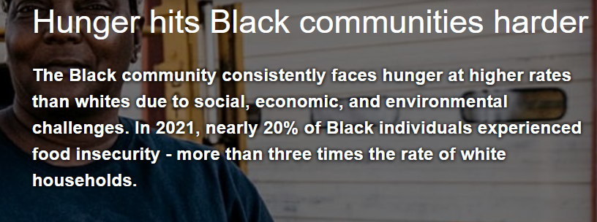
United States: COMMUNITY
Prayer items:
Pray that the stronghold on gun violence would stop
Pray that young people who are perpetrators of violence would be awakened by a God given purpose
Pray that Black communities would find favor with God in the areas of social, economic, and environmental challenges

Slide 11
United States: CHURCH
Prayer Items
The church would step-up to attend to the spiritual and physical needs of the people
God would still show himself as God

Slide 12
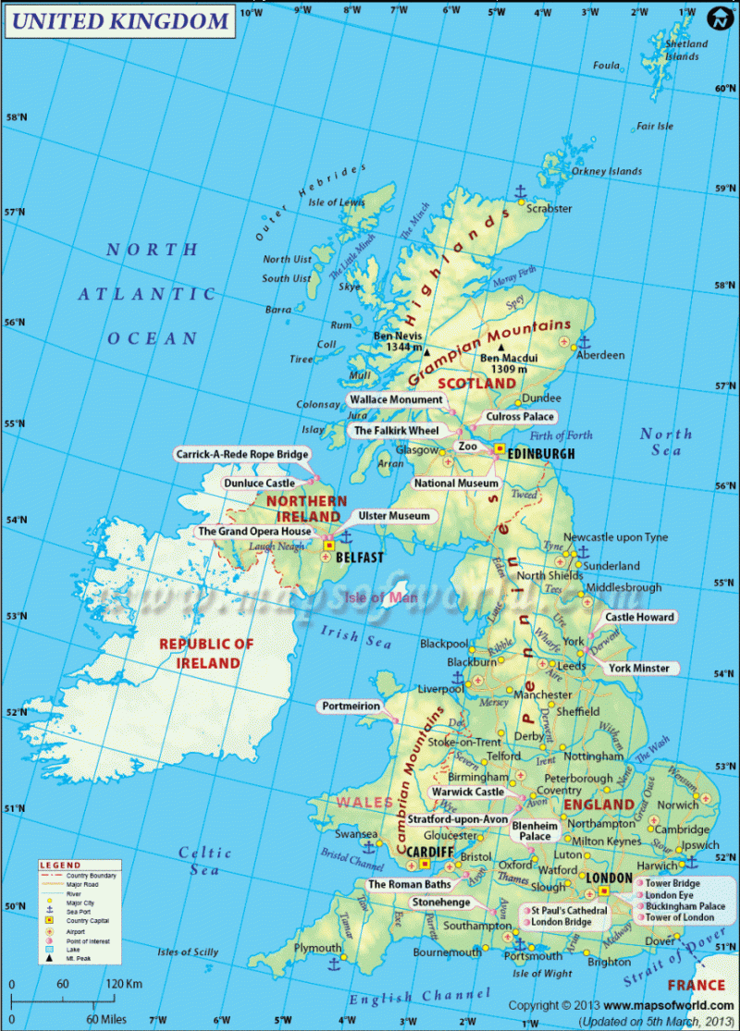
United Kingdom: COMMUNITY
Prayer items:
Broken Families
Absent fathers will return to their children
That the knife and gun violence among young Black men-They will live and not die to fulfill their destiny.

Slide 13
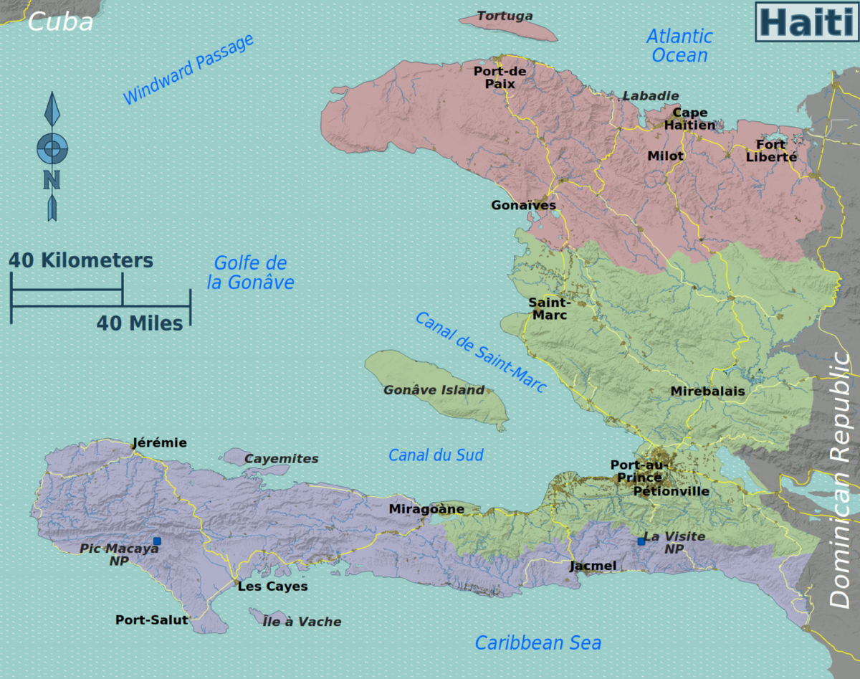
PRAYERS FOR HAITI
This Photo by Unknown Author is licensed under CC BY-SA

Slide 14
Considered France's richest colony in the eighteenth century, Haiti was known as “the pearl of the Antilles.” Resisting their exploitation, Haitians revolted against the French from 1791-1804

Slide 15
In 1825, Haiti was forced to pay millions of French francs to France in exchange for that country's recognition of its sovereignty
Haiti

Slide 16
"There is no legitimate government, no judiciary, no parliament, and a weak police force incapable of stopping the gangs that now rule over 60% of the capital. There is no chance of planning elections under the current security crisis….

Slide 17
.. Gangs are hijacking boats, planes, and trucks that are attempting to deliver critical food and medical items to the most vulnerable. Just this week two UN food warehouses were broken into and then burned.” Ambassador P.W

Slide 18
HAITI
Prayer Items
Haiti would be a place of remembrance
United in Prayer for Forgiveness and Reconciliation in our Country Haiti. United in Prayer to ask God to bring Justice and Political Stability in Haiti

