Slide 1
Call to Prayer
26 May 2022

Slide 2
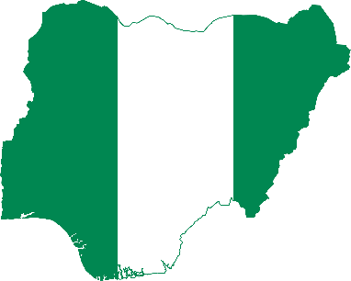
Dear Father, we thank you for Nigeria as a nation, its diverse peoples and cultures.
In Your divine wisdom You placed us together for a purpose.
Lord, thank You for manifesting Your divine power and unleashing Your purposes in and through Nigeria.

Slide 3
Lord, we thank You for a vibrant missional Church through the years.
Thank You for making the Church in Nigeria, a missionary sending Church, committed to taking the gospel to the ends of the earth in fulfilment of the missional mandate – Matt 18:18-20.
Thank you for many graduates who have committed their lives to serving in various missions fields within and outside Nigeria.

Slide 4
Father Your Word says that “there is no authority except from God, and the authorities that exist are appointed by God.”
We therefore believe our leaders have been appointed by You Lord.
Please grant them a change of heart to lead the Nation out of the present crisis of gargantuan national insecurity conundrum, in the mighty Name of Jesus.

Slide 5
This is also a very difficult period for the Church in Nigeria with the activities of the triumvirate of evil: Boko Haram, Fulani Herdsmen and Bandits. There are several Christian girls now in Boko Haram captivity – Leah Sharibu, Alice Ngaddah, Grace Tuka, Lilian Gyang Daniel, Praise Austin, and several others.
We have also just witnessed the jungle justice lynching type murder of 25-year-old College Student, Deborah Emmanuel, through stoning and burning in the name of blasphemy by Islamic zealots in Sokoto State on May 12th 2022.

Slide 6
Father we believe that our nation can be guided into the Light of Reconciliation and Peace, out of the darkness of sin and revenge/retaliation.
Let this happen in our Land today in the Name of Jesus.

Slide 7
Father Lord there have been many predictions of looming war and woes on Nigeria.
Turn these predictions around into blessings and progress. Throughout history You have intervened divinely and turned back war mongering to peace mongering.
Remember Nigeria at this dark hour of cloudy uncertainties.

Slide 8
Bring redemptive transformation to Nigeria through the Gospel as good news of peace and prosperity in the hearts of many citizens in Nigeria.
Let the overwhelming number of churches become effective as they preach and focus on Holiness and transformational living with kingdom values.

Slide 9
Lord bring UNITY of PURPOSE to the Church in Nigeria, Lord!
Unite her leaders.

Slide 10
Destroy the evil of religious fanaticism, extremism and ideological manipulation for destructive purposes.
Let there be massive tidal waves of social movements across ethno-religious groups in support of normalcy which will usher in peace, stability, progress and development.

Slide 11
Prayer for the on-going primaries for elective offices holding throughout this week in all the political parties in Nigeria.
This will culminate in the election of all candidates that will stand for elective offices in 2023; including the office of President.

Slide 12
As Nigeria has been known for Corruption let there be new leaders of INTEGRITY that will model and drive change, and the new Nigeria shall be known for Righteousness and Holiness.

