Slide 1
2 Chronicles 7: 14
AFREG DRC

Slide 2
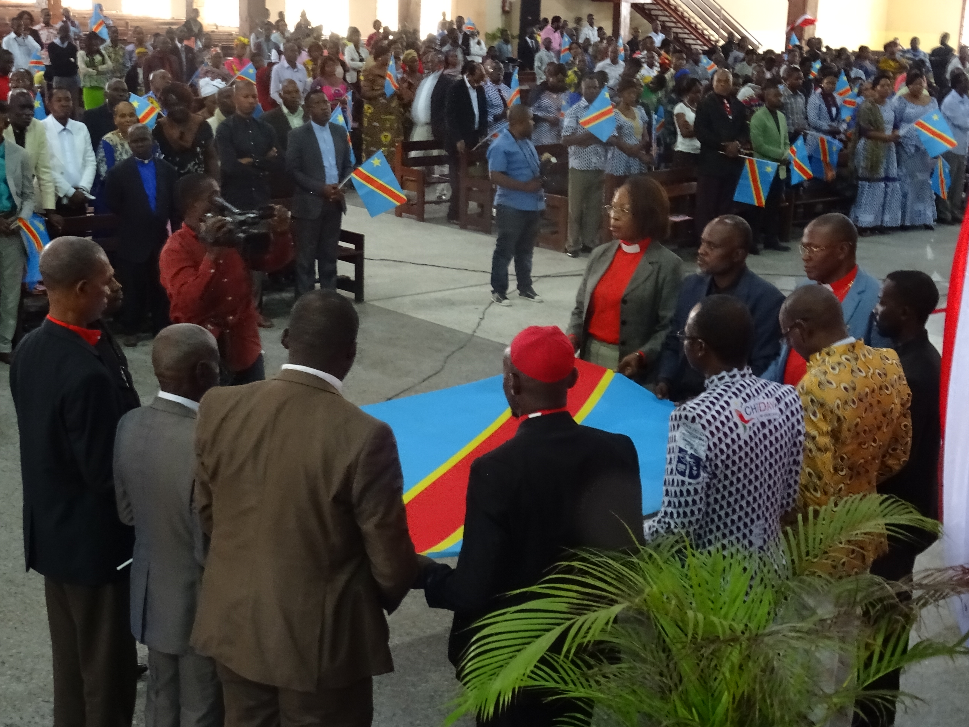
Introduction
The DRC is a vast African country with an area of 2,345,000 Km2 and a population of 90,000,000 inhabitants with 226 Tribes including 154 unreached tribes with a combined population estimated at 36 Million.

Slide 3
PRIONS POUR LA REPUBLIQUE DEMOCRATIQUE DU CONGO

Slide 4
THANKSGIVING :
We thank God for the transition from 2021 to 2022 despite the Covid-19 pandemic. We thank the Lord for the initiative of our Head of State who has publicly consecrated the country to the Lord in his address to the nation. We are grateful to God for the role that the body of Christ in Congo has played by being part of the leaders of the Independent Electoral Commission, the CENI (Commission Nationale Electorale Indépendante in French). This has prevented political instability. Glory be to God for the significant progress in the country’s leadership despite the opposition. We thank God for the role of the two chambers of parliament as they work for in for the well-being of the people.

Slide 5
BODY OF CHRIST in CONGO :
Let us pray for the harmony amongs the leaders of the body of Christ in Congo (ECC: Church of Christ in Congo, ERC: Church of revival in Congo, Catholic Church,...) so that the church remains “in the middle of the village” for the total liberation of the DRC. May leaders be role models in good governance and may God forgive all our religious leaders for their compromise in the management of public affairs. Let us pray for the transformation of all pseudo-religious leaders (who illicitly enrich themselves by impoverishing members)

Slide 6
BODY OF CHRIST IN CONGO:
May God sustain the faith of the Congolese because of the heresies and false doctrines taught by false pastors, false prophets and false teachers. May God help our religious leaders to get involved in political life. Let us pray for the reign of God in the DRC (worship of the living God be at the heart of the nation) Let us pray for righteousness

Slide 7
THE PRESIDENCY OF THE REPUBLIC & THE GOVERNMENT
PRESIDENCY Let us pray for President Felix Antoine TSHISEKEDI that he will complete his electoral mandate in style with the support of God. May God bless his political agenda and leadership. During our prayer breakfast before Covid 19, the Head of State who listened to the intervention of Dr. Victor Koh had made the promise to collaborate with ILF. May The Lord touch his heart to honor his promise. THE GOVERNMENT Let us pray for the effectiveness of the rule of law in the DRC and the National Strategic Plan for Development (PNSD). May God bless our Prime Minister , all the ministers and the government’s agenda: Building a strong, prosperous and united state

Slide 8
SOCIAL & Security ASPECTS
SOCIAL LIFE OF THE CONGOLESE The economic crisis is glaring in the DRC despite the potential wealth that abounds in the country. Owning 80% of our land is arable, but we import 80% of the food. May God help us to develop this sector. Let us pray to stop all the elements that trigger insecurity and anti-values such as tribalism, corruption, hatred and nepotism, ... Let us pray for the social progress and development of our nation.

Slide 9
SOCIAL & Security ASPECTS
SECURITY PLAN A group of bandits with knives and other weapons (called the Kuluna) that worries the population in the big cities The eastern part of the country is besieged by the factions of rebel groups (Ex: M23, ...). We want God to help us to apply the policy of good neighborliness to ensure peace in the common borders with the 9 neighboring countries. Let the hostilities in the east of the country cease. Let us pray for a total end to the war in eastern DRC. Let us pray for the military and police authorities that their professionalism will help us lead a peaceful life.

Slide 10
Youth
Let us pray that God will raise up a generation of conscious, autonomous and honest young people who live far from all forms of manipulation but are committed to building the future of our nation. That teachers (schools, universities,...) play a role in holistic training of young people in order to ensure the succession in the country's institutions. Let us pray for the government's program to reintegrate uncivil youth into the centres of education and apprenticeship in the trades.

Slide 11
FAMILY
May the family be a centre of influence for our children. May Jesus Christ be the only center of worship of our families (the sacredness of the family). Let us pray for the multiplication of stable families in order to avoid trends like: ''Vulnerable children‘’ (witch/wizard children, street children,...)

Slide 12
AFREG DRC
Let us pray for the meeting to present the AFREG vision to the religious and political authorities. Let us pray for the recruitment of the new members. Let us pray for an AFREG summit in the DRC.

